Slide 1

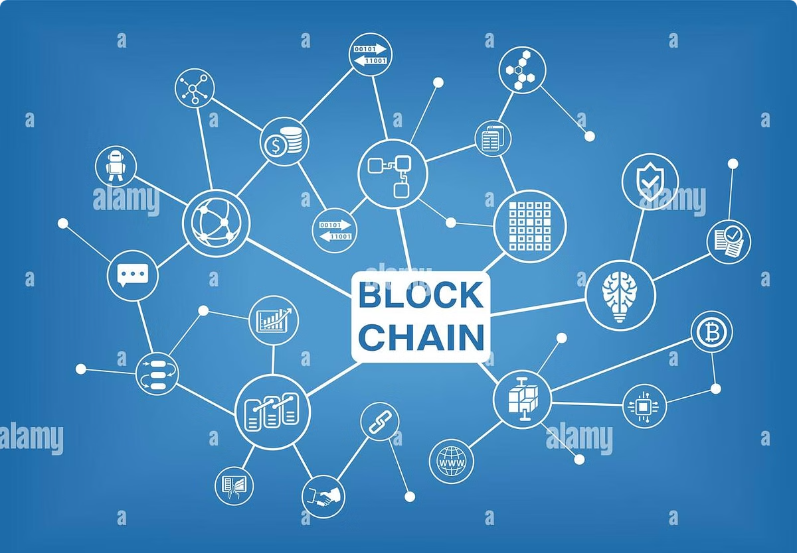
Blockchain’s Role in Finance Beyond Cryptocurrency
Blockchain technology, initially designed for cryptocurrencies like Bitcoin, has evolved to revolutionize other areas of finance.
Presented By: Omkar Ghodekar
TECO2425B070 TE Computer Engineering
Guided By: Ms. T. B. Tambe

Slide 2
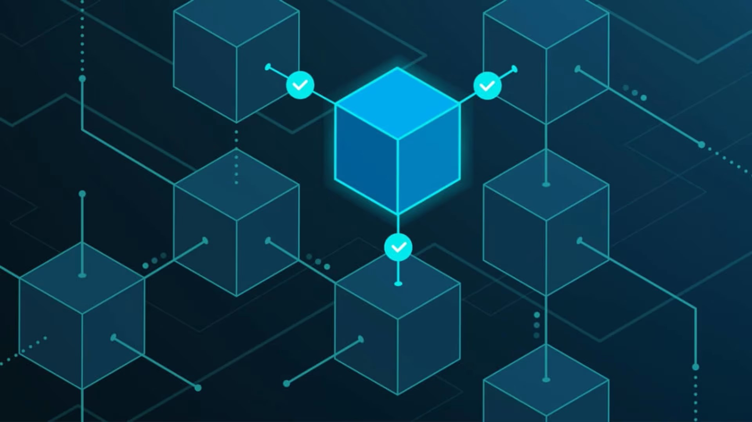
Index
Introduction
Abstract
DeFi VS CeFi
Block structure
Applications
Challenges
Algorithms
Future Scope
Conclusion

Slide 3


Introduction
1
Background
Blockchain was introduced in 2008 with Bitcoin, marking the start of decentralized, peer-to-peer financial systems.
2
Key Attributes
Decentralization, transparency, and security are key attributes of blockchain technology.
3
Beyond Bitcoin
Applications have expanded into other areas like DeFi, enabling automated financial services through smart contracts and distributed networks.

Slide 4

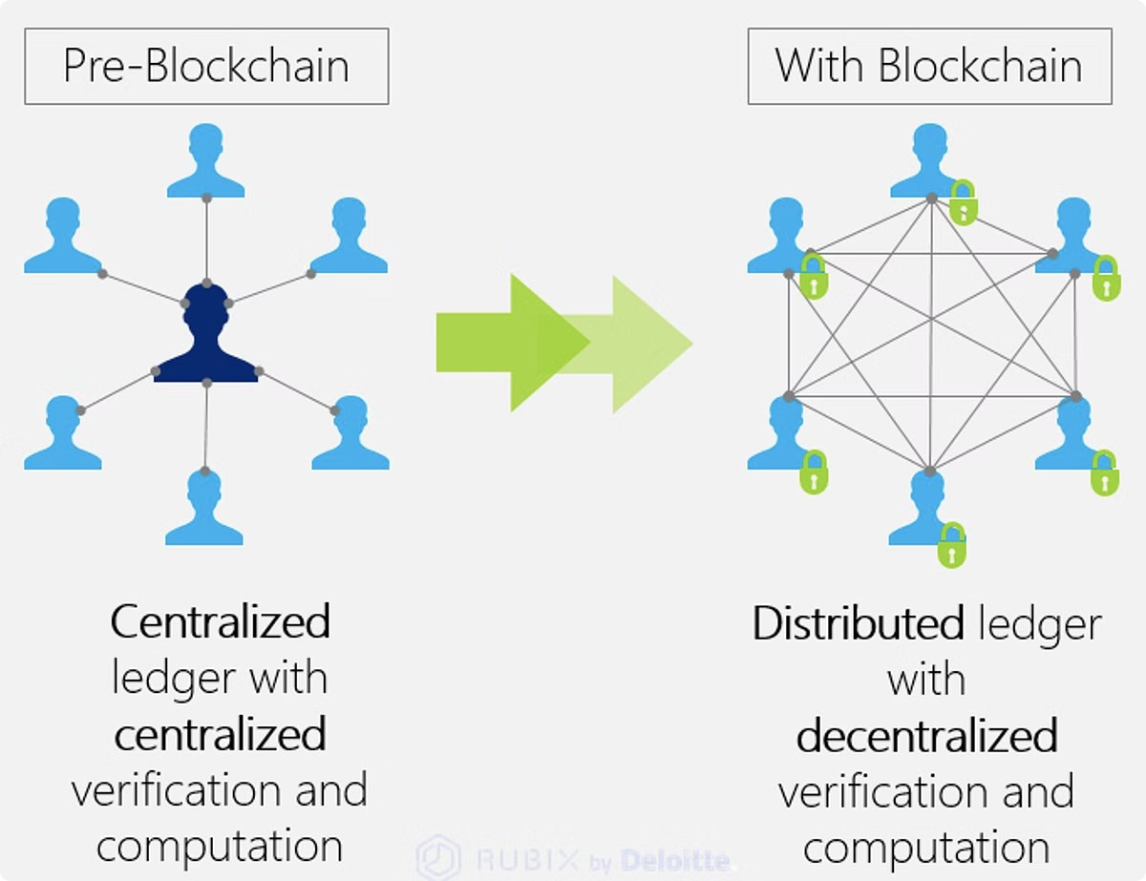
Abstract
1
Blockchain Evolution
Initially designed for cryptocurrencies like Bitcoin, blockchain technology has evolved to revolutionize other areas of finance.
2
Focus Areas
Decentralized Finance (DeFi), Asset Tokenization, and Cross-border Payments are key areas where blockchain is making a significant impact.
3
Security & Transparency
Blockchain’s inherent cryptographic security and distributed ledger offer more transparent financial operations.

Slide 5
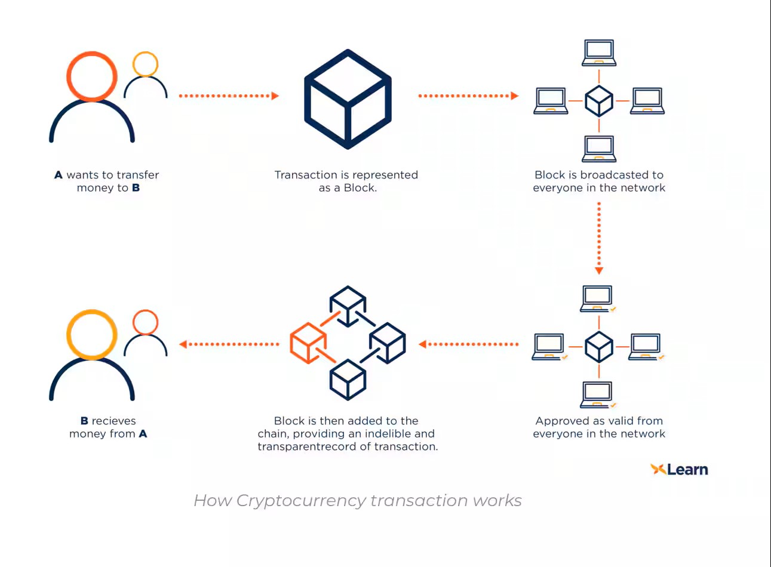

Slide 6
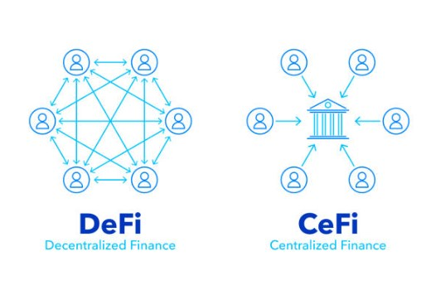
DeFi VS CeFi

Slide 7
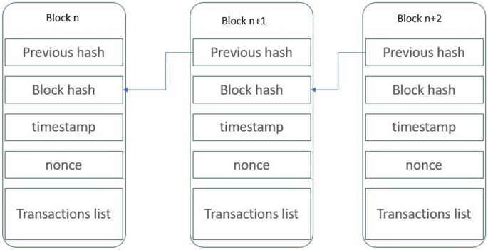
Block structure

Slide 8
Decentralized Finance (DeFi) & Financial Transformation
DeFi Explained
Smart Contracts
Advantages
An ecosystem of financial applications built on blockchain networks (mainly Ethereum) that operate without centralized intermediaries.
Self-executing contracts with predefined rules coded into the blockchain, enabling automated loans, yield farming, and insurance without a middleman.
Accessibility, transparency, and reduced costs are key advantages of DeFi.

Slide 9


Blockchain Applications Beyond DeFi
Cross-border Payments
Supply Chain Finance
Asset Tokenization
Blockchain eliminates intermediaries, enabling near-instant payments with lower transaction costs.
Blockchain enables real-time tracking of goods and assets across borders, reducing fraud and ensuring integrity.
Converting physical assets into digital tokens on a blockchain enhances liquidity, fractional ownership, and global investment opportunities.

Slide 10

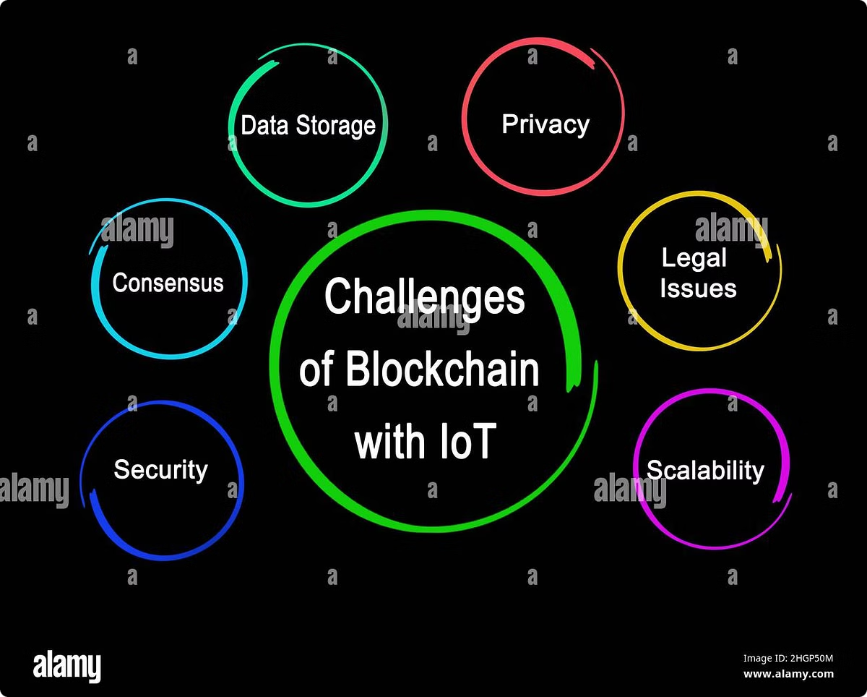
Key Challenges
Scalability
High transaction fees and slower processing times during peak periods.
Regulatory Issues
Blockchain’s anonymity conflicts with Anti-Money Laundering (AML) and Know Your Customer (KYC) regulations.
Security Concerns
Poorly coded smart contracts can be exploited, and networks are vulnerable to 51% attacks.

Slide 11
Algorithms
1. Cryptographic Hash Functions
Definition: Converts input data into a fixed-length string, ensuring uniqueness.
Formula: H(x)H(x)H(x) → unique hash for input xxx
Key Properties:
Deterministic: Same input = same output.
Pre-image Resistance: Hard to reverse to find the original input.
Collision Resistance: Hard to find two different inputs with the same hash.
2. Public-Key Cryptography
Definition: Uses a public key (shared) and a private key (kept secret).
Formula: Public Key: PKPKPK, Private Key: SKSKSK
Key Properties:
Secure Communication: Only the intended recipient can decrypt.
Digital Signatures: Ensures authenticity and integrity.

Slide 12

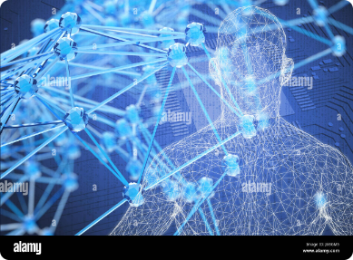



Integration with Emerging Technologies
AI in Blockchain
IoT and Blockchain
Future Integration
AI can analyze blockchain data in real-time to detect suspicious activity and power smart contracts.
Blockchain can automate machine-to-machine payments or ensure the authenticity of products in the supply chain.
Expect blockchain, AI, and IoT to converge, leading to automated, secure financial and business operations.

Slide 13


Conclusion
Blockchain is transforming finance beyond just cryptocurrency, from DeFi to cross-border payments and asset tokenization. Scalability, security, and regulatory frameworks remain barriers to mainstream adoption. AI, IoT, and quantum-resistant cryptography will shape the future of blockchain, ensuring its long-term viability in the financial world.

